Slide 1

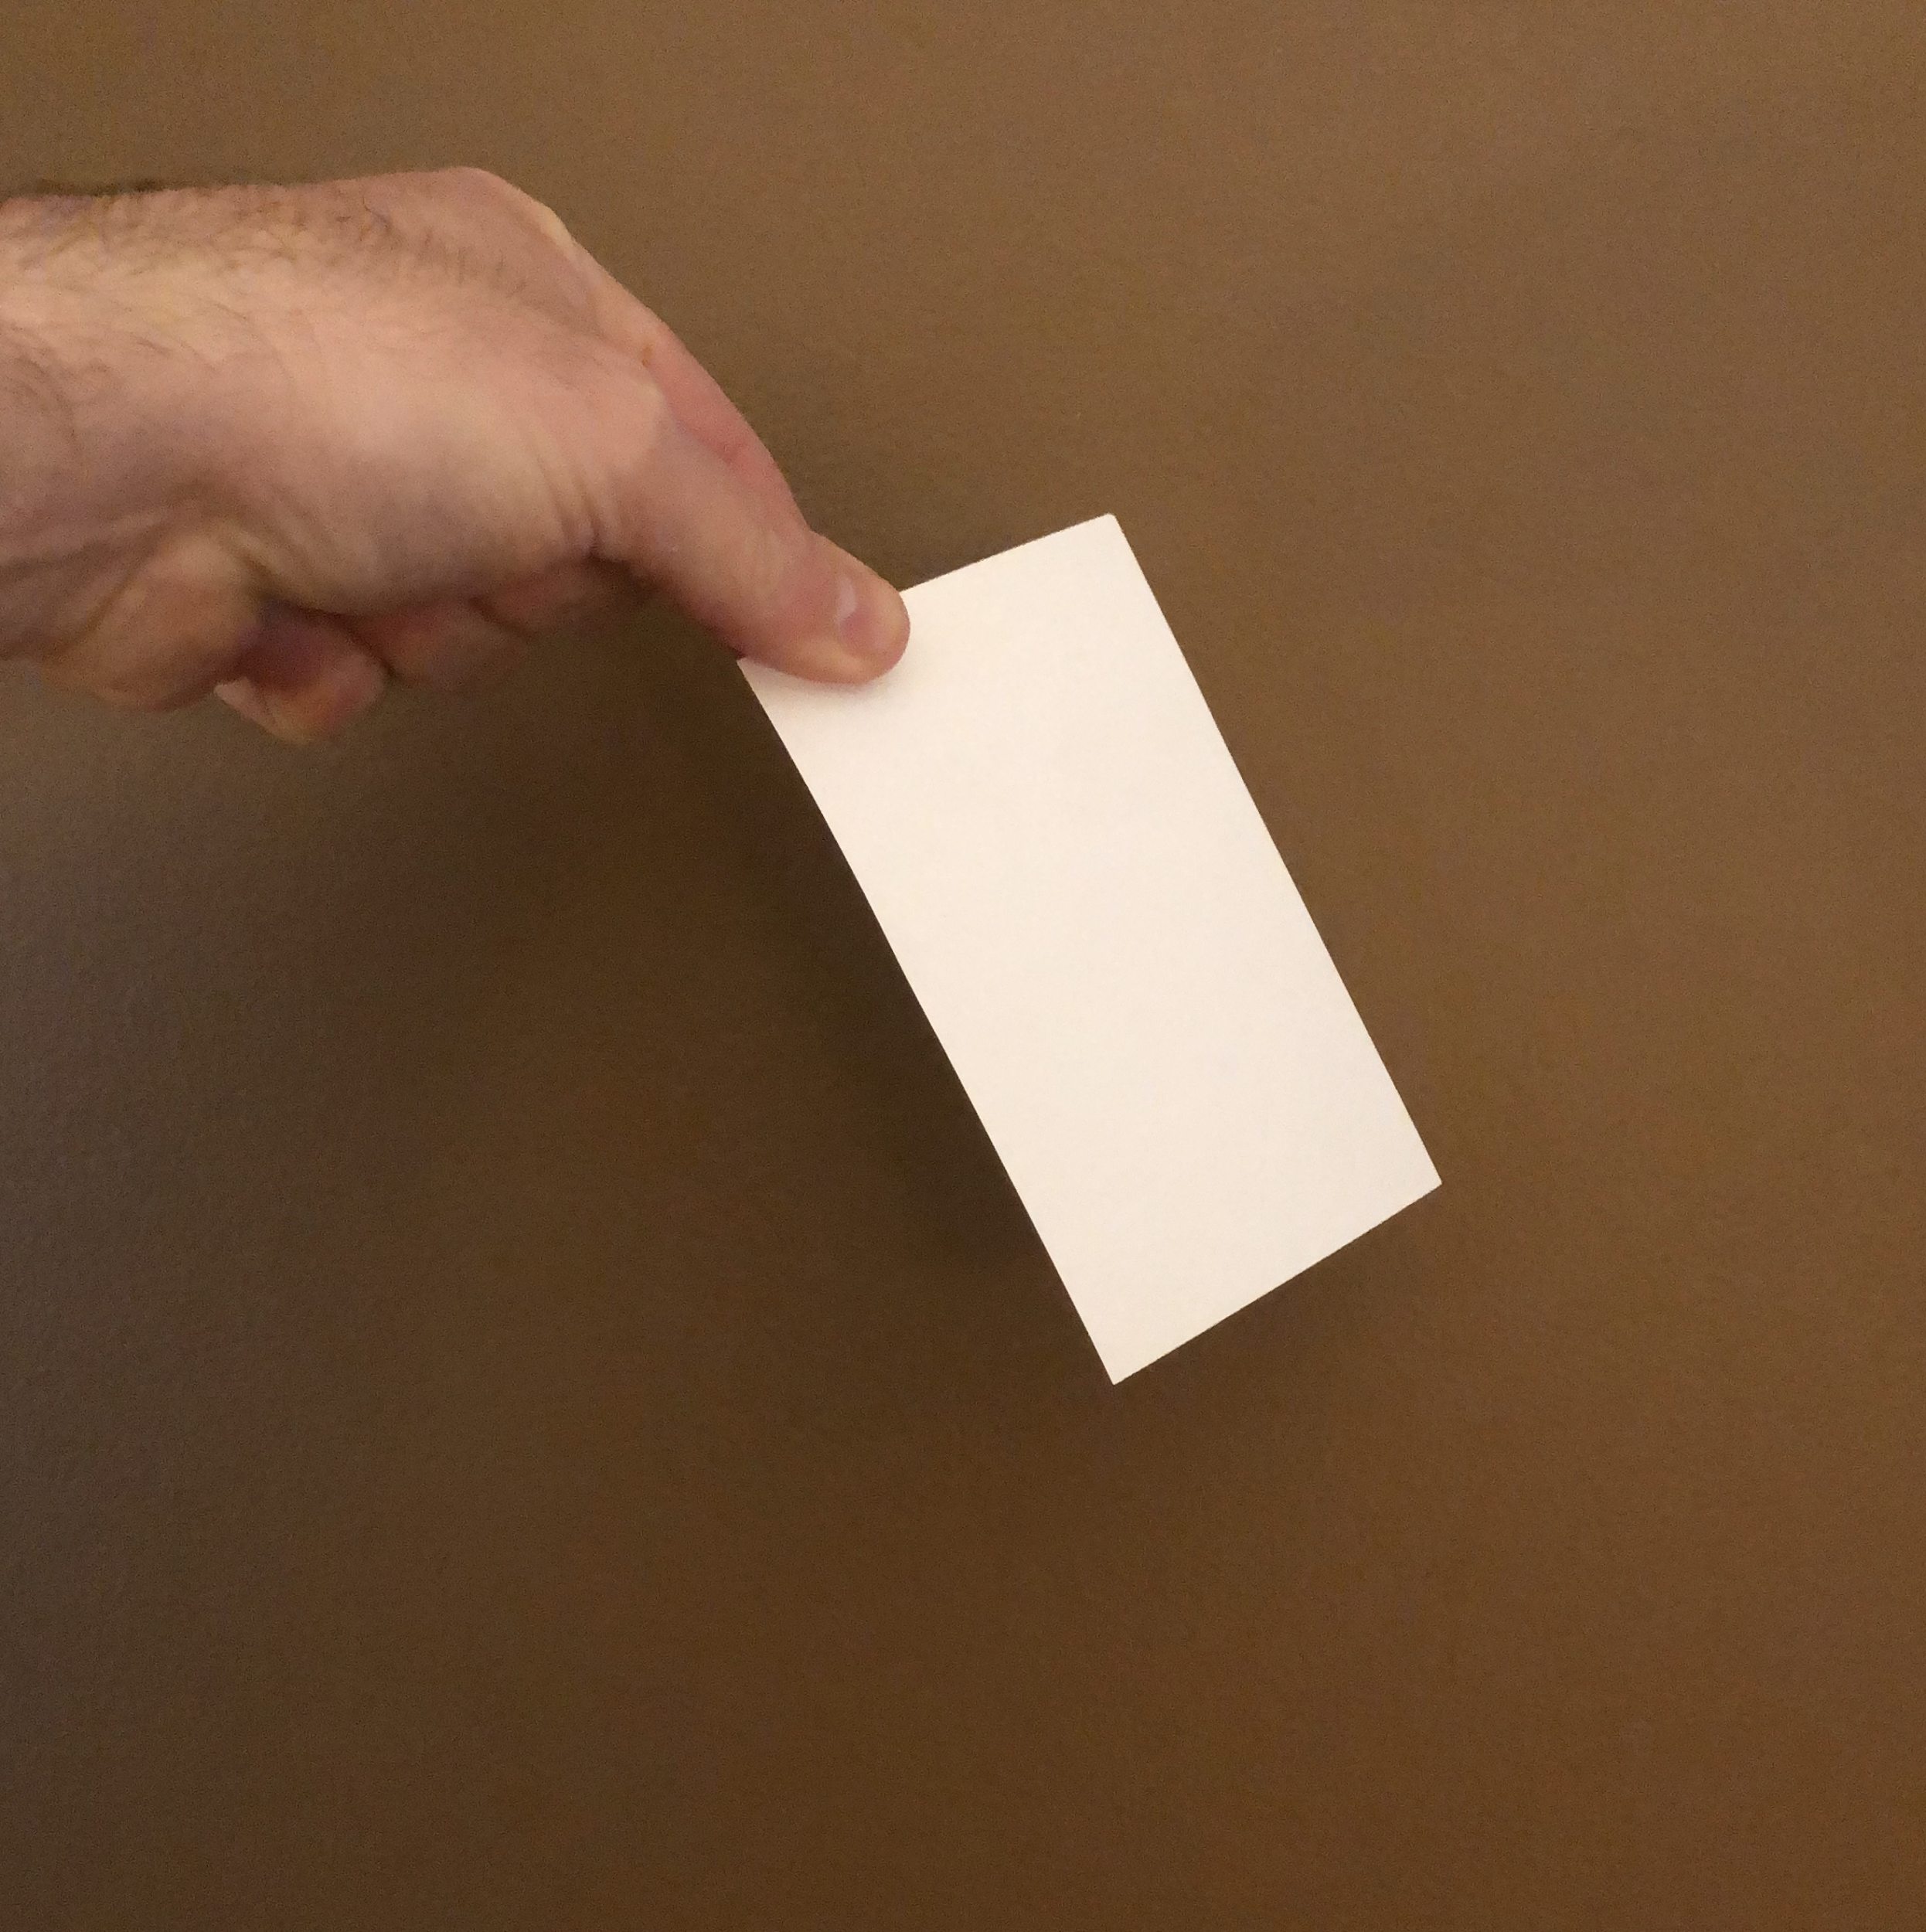
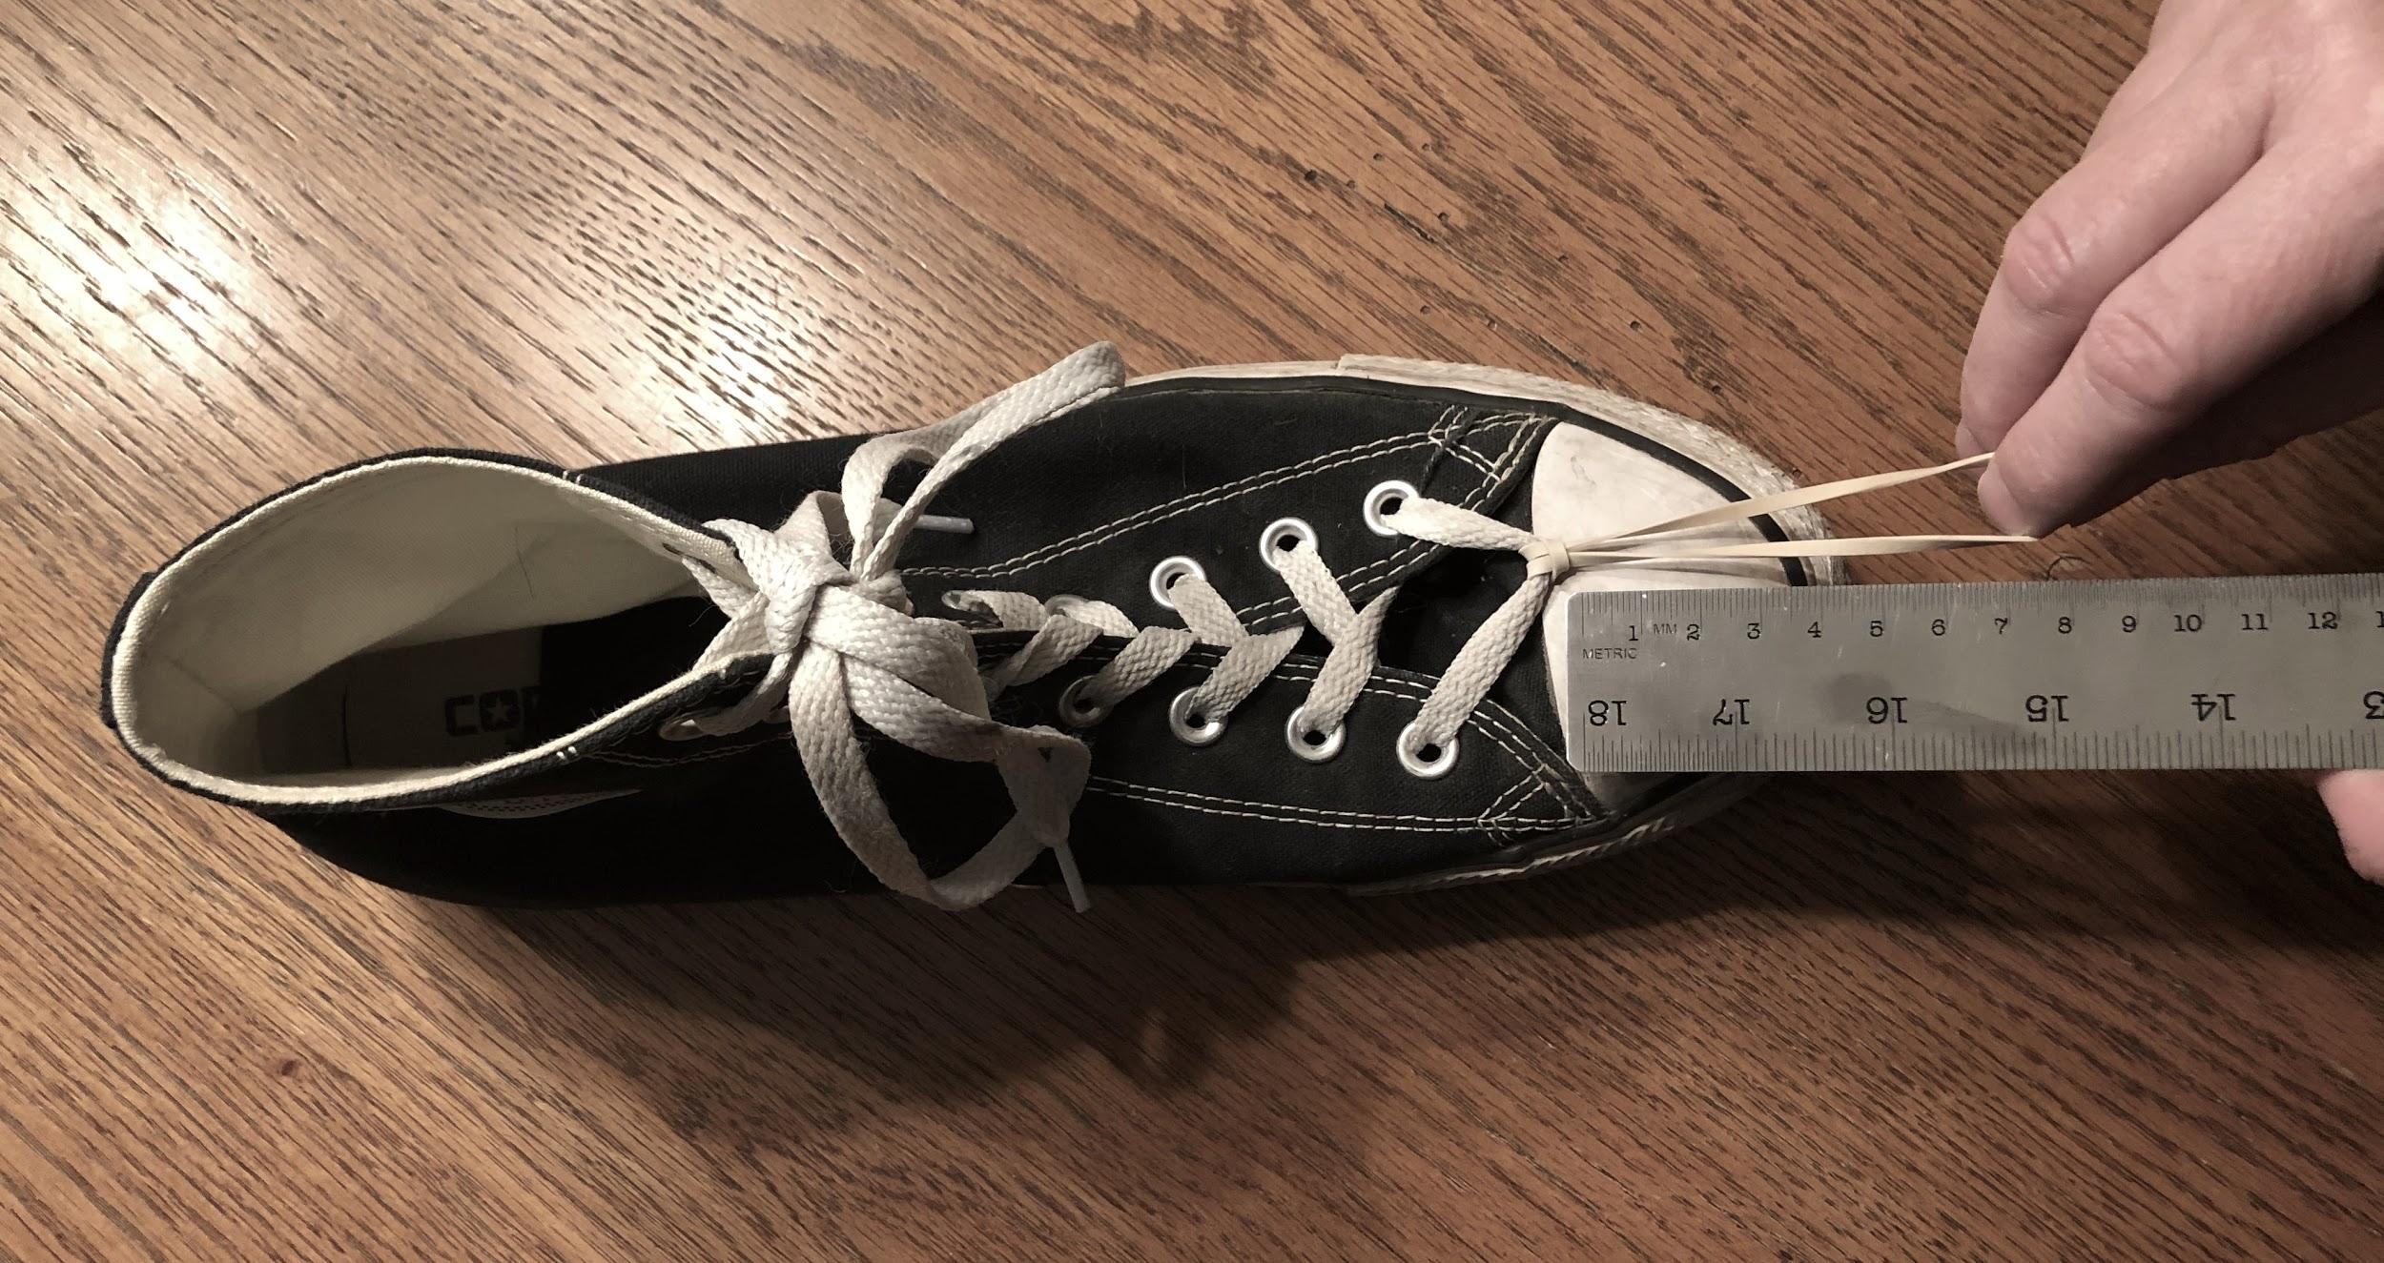
Slide A
Sharing Results from Our Home Learning Investigations
Small-Group Discussion
Pair up so that there is one person with results from each investigation.
Have each person share their responses to the last two questions on their handout (2 min per person).
Folding and dropping paper
An air interaction investigation
Pulling a shoe with a rubber band
A surface interaction investigation
Notes:
Revisit home learning. Say, After our last lesson, you completed some investigations at home, so let’s share our results with a partner. Display slide A. Have students stand up and move to one of 3 different areas of the room that corresponds to the investigation(s) they completed:
Interactions with the Air investigation
Surface Interactions investigation
both investigations
Instruct students from area A to pair up with someone from area B. Any extras in either group should pair up with someone from area C. Any extras in area C after that can pair up with each other.

Slide 2

Slide B
Navigation
With Your Class
What ideas do you have from the home learning that could help explain where other contact forces in the system may be causing the box to slow down and eventually stop?
Notes:
Lead a whole-group discussion using the question on the slide. Say, We know from our last lesson that speed and mass both affect the kinetic energy of an object. We also know that something is causing objects (like the cart and box) to lose kinetic energy after a collision. Display slide B. Use the prompts located in the teacher guide to support this brief discussion.
Connect this to energy transfer questions from the last lesson. Say, In our last lesson we raised some new questions about where energy was going to in the system. Let’s decide what we should do next.
Motivate the need for further investigations. Say, OK, it sounds like we are going to need to update this system model. And it sounds like we should collect some more evidence about some of the places where these contact forces are causing energy to be transferred to other parts of the system. I have some equipment and materials we can use to investigate these types of interactions further. Let’s make note of the question we are trying to make further progress on.
Write this question on the board:
How do other contact forces, like friction and air resistance, cause energy to be transferred between a moving object and other parts of a system?

Slide 3

Slide C
Conducting Investigations
Follow the directions posted at each station for collecting evidence about other contact forces that may affect motion and energy.
With Your Group
Station 1. Cart with sail interacting with air
Description | Observations / Insights
Cart with a sail
Cart without a sail
Notes:
Share directions for station investigations. Display slide C. Explain that student groups will rotate through four stations where they will investigate other instances of objects slowing down or producing another interesting outcome related to one of the two additional types of contact forces we have discussed are missing from our system model--friction and air resistance.
Be sure to post the activity instructions, Lab station instructions, at each station. Distribute Data collection from stations and tell students to record on the handout their observations and any insights they have about these other forces that are not accounted for in our model.
Allow students approximately 20 minutes to engage in the stations, asking them to rotate every 5-6 minutes.

Slide 4


Slide D
Construct an Argument from Evidence
On Your Own
Construct an explanation to answer this question:
How do other contact forces, like friction and air resistance, cause energy to be transferred between a moving object and other parts of a system?
Include answers to these questions:
What causes these forces?
How do these forces transfer energy in the system?
What evidence from your assigned station investigation supports your explanation?
Be ready to share your ideas in our next class meeting!
Notes:
Construct an evidence-based explanation. Display slide D. Say, Next time, we will work as a class to identify the most relevant ideas we have for developing a more-complete model of the forces affecting moving objects before, during, and after a collision. Today, let’s spend the last few minutes of class organizing the ideas you have now into some explanations.
Have students count off 1-4 to assign each student one of the stations from today’s investigations. Explain that each student will create an explanation for the one station they have been assigned, not all stations they visited. This will allow for multiple individuals to analyze the same data, and as a class we can compare findings later, which is what scientists also do in their professions. Say, When you develop your explanation you will focus on the evidence collected and the observations and insights you recorded from only one station. Your explanation should help answer the question: How do other contact forces, like friction and air resistance, cause energy to be transferred between a moving object and other parts of a system? Be sure to describe what causes these forces, how these forces transfer energy in the system, and the evidence from your assigned station investigation that supports your explanation. I will collect your explanations so I can get a sense of what you are thinking and then return them to you next time.
Give students time to write and collect their work at the end of class. Students can write explanations in their notebooks or on blank paper for ease of collection.

Slide 5
Slide E
Navigation
On Your Own
Reread your explanation you made last time to answer this question:
How do other contact forces, like friction and air resistance, cause energy to be transferred between a moving object and other parts of a system?
Prepare to share this explanation with others by highlighting or underlining the ideas you want to emphasize and that are important to add to our model.
Notes:
Connect to explanations for investigation stations from the previous class. Return student claims. Display slide E. Say, Today we are going to work in jigsaw feedback groups to share our claims. Each group will consist of students who wrote claims about different stations. Each station will have at least one person in the group who wrote a claim about it. Before we begin, take some time to think about how you will share your claim and highlight or underline the important ideas you want to emphasize with your classmates.

Slide 6
Slide F
Review Our Norms
Classroom Norms
Respectful Our classroom is a safe space to share. | We provide each other with support and encouragement. We share our time to talk. We do this by giving others time to think and share. We critique the ideas we are working with, but not the people we are working with.
Equitable Everyone’s participation and ideas are valuable. | We monitor our own time spent talking. We encourage others’ voices who we have not heard from yet. We recognize and value that people think, share, and represent their ideas in different ways.
Committed to our community We learn together. | We come prepared to work toward a common goal. We share our own thinking to help us all learn. We listen carefully and ask questions to help us understand everyone’s ideas. We speak clearly and loud enough so everyone can hear.
Moving our science thinking forward We work together to figure things out. | We use and build on others’ ideas. We use evidence to support our ideas, ask for evidence from others, and suggest ways to get additional evidence. We are open to changing our minds. We challenge ourselves to think in new ways.
Notes:
Discuss norms for giving and receiving feedback. Display slide F. Ask students to revisit the classroom norms and to share ideas for which norms are especially important when giving and receiving feedback. Allow a few students to quickly share their thinking with the class and listen for ideas such as the following:
We critique ideas, not people.
We encourage other voices that haven’t been heard yet.
We listen carefully and ask questions to help us understand.
Say, These are all important to help us learn from each other as we share our explanations in our groups.

Slide 7
Slide G
Jigsaw Feedback Group Discussion
With Your Feedback Group
Take turns sharing and defending your explanation with your group members.
Use the discussion questions on your handout to identify important ideas to add to our model.
Station 1. Cart with sail interacting with air
Discussion question | What ideas do you want to add to our model?
How are forces on the cart different with and without the index card?
How is the behavior of the index card evidence that there is a contact force on part of the cart-subsystem?
Notes:
Display slide G. Explain that group members will each take turns sharing and defending their explanations. Distribute Jigsaw feedback discussion. Guide students to use the discussion questions on this handout to push thinking about each of the four stations so that students can explain the cause-effect relationships for the motion and kinetic energy changes in the launcher system.
Say, Spend five minutes discussing the explanation made for each station. As you engage in discussion with your group, listen for similarities and differences in your claims and identify the most relevant ideas to add to our model and add those to your handout.

Slide 8
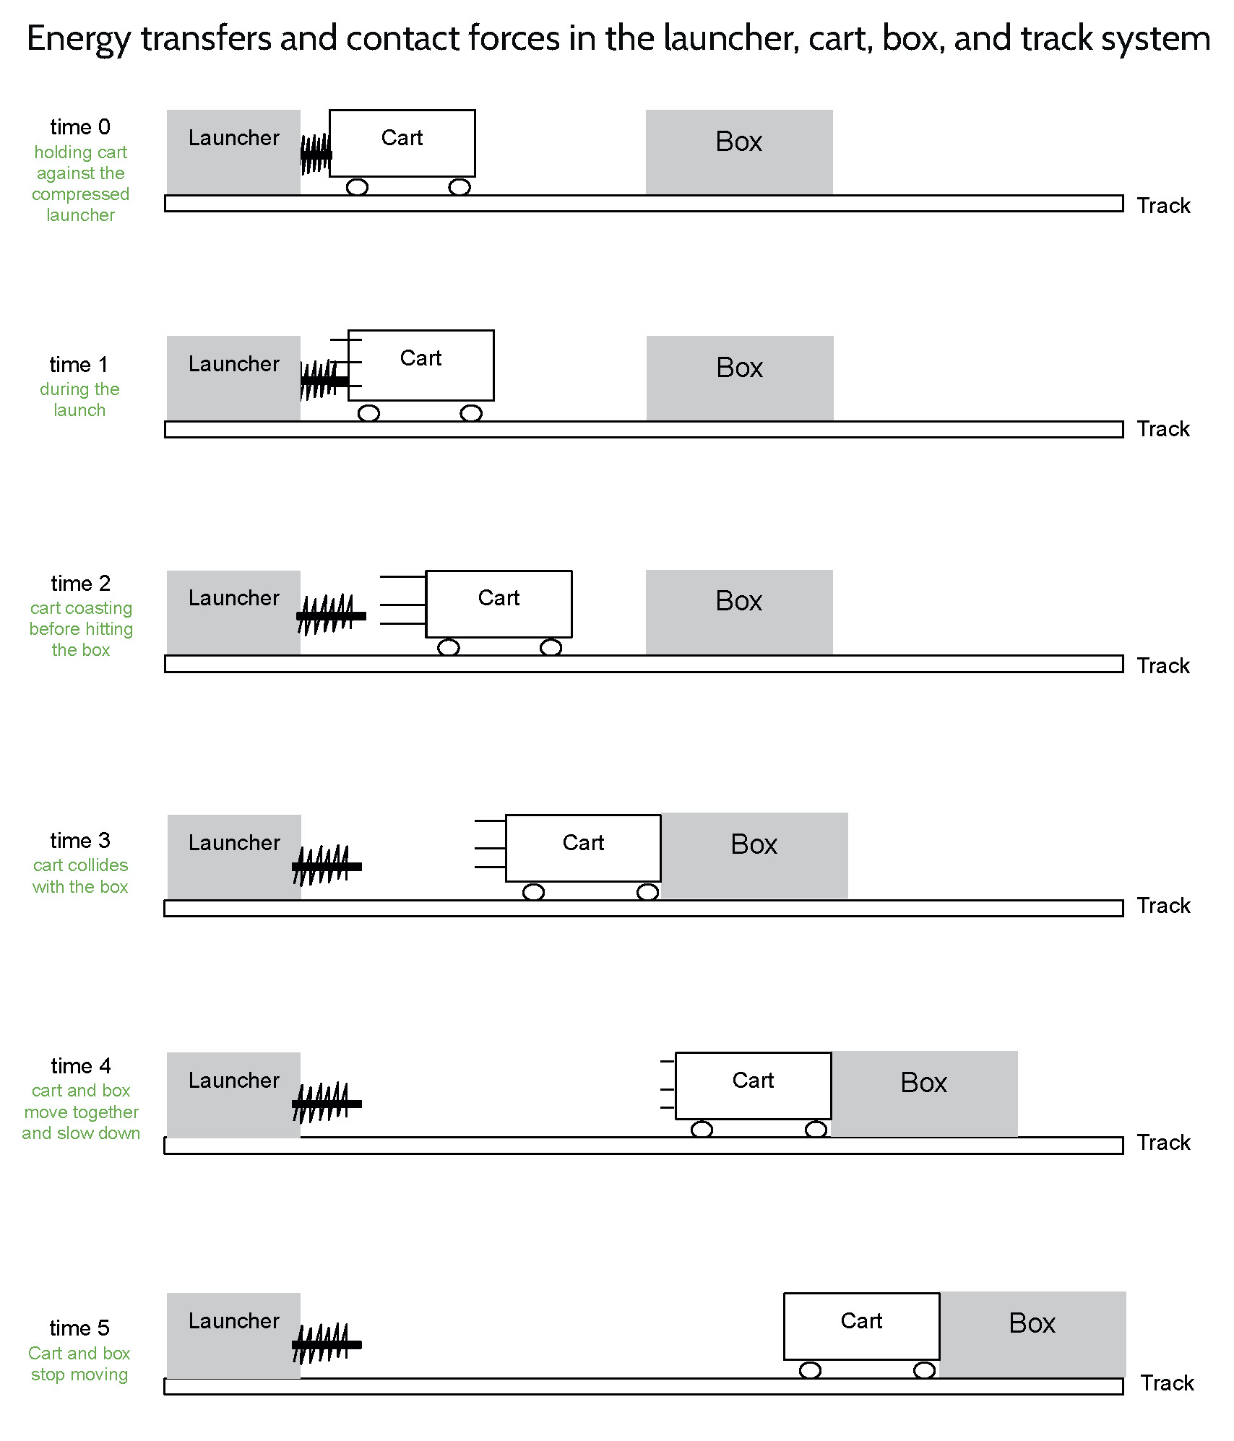
Slide H
Revising Our Cart-Launcher System Model
With Your Class
Let’s revise our model based on our ideas about how other contact forces, like friction and air resistance, cause energy to be transferred between a moving object and other parts of a system.
Notes:
Gather the class in the Scientists Circle. Display slide H. Say, I heard some really great connections being made as groups discussed their explanations. Let’s share and record the relevant ideas we have for revising our previous model we developed for our launcher system. Have students bring their notebooks, colored pencils, and their copies of Jigsaw feedback discussion.
Display the Energy transfers and contact forces in the launcher, cart, box, and track system poster with the sticky note annotations on it, as shown here. Lead a Building Understandings Discussion to explain what other forces affects the motion and kinetic energy of the cart before a collision.
Ask, Does anyone have an idea to share about where else contact forces cause energy to be transferred between different parts of the launcher system? Listen for these ideas:
The cart is colliding with air particles, and this causes the cart to slow down and lose kinetic energy.
The cart is slowing down and losing kinetic energy because of friction between the cart’s wheels and the track.
The track must gain kinetic energy as increased particle motion (heat) as the cart moves over the track surface.
Ask, If there are collisions between the cart and air particles, what changes about the air particles? Listen for these ideas:
The air particles gain kinetic energy after collisions with the cart.
The air particles heat up after collisions with the cart.
Example prompts and responses are located in the teacher guide.
Have students add annotations to their copies of Jigsaw feedback discussion to represent these ideas.

Slide 9

Slide I
Update Our Progress Trackers
In Your Notebook
Create an entry in the Progress Tracker section of your notebook and record our lesson question and what we’ve figured out.
Question | Source of evidence
How do other contact forces, like friction and air resistance, cause energy to be transferred between a moving object and other parts of a system?
What I figured out in words and pictures
Summarize these here
Include our updated launcher system model here
… add additional words and phrase to further explain your thinking now.
Notes:
Display slide I. Say, Let’s update our Progress Trackers with these new ideas. In the Progress Tracker section of your notebook, make a three-part table to record the lesson question, sources of evidence, and what we’ve figured out.
Have students add or move their copies of Jigsaw feedback discussion to this section of the Progress Tracker. If they can’t because they already glued these into their notebooks, they can add a reference page number to this entry (e.g., “see page X of the notebook”). Encourage students to use the remaining time to add descriptions in words for what they figured out that is represented in the system model we developed as a class.

Slide 10

Slide J
Revising Your Individual Model
Home Learning
Review the model and explanation you developed before this lesson for what you thought was going on at time 4.
Use a new color to modify this model and explanation so that it represents your new thinking based on what you figured out in this lesson.
Notes:
Say, Wow, we have really made progress on our model and filled in a lot of gaps to show what’s happening in the system before, during, and after a collision. We accounted for forces and energy changes when parts of our system are speeding up, slowing down, and colliding. We also figured out a lot about what can contribute to damage in a collision. Let’s take stock of what we know next class and see if we can explain why some objects break or don’t break in a collision.
Introduce the home learning. Say, In preparation for that, look back at the previous models and explanations you developed in the last lesson and consider what you would change about them now in light of what you figured out in this lesson.
Distribute the previously completed copies of Modeling other force interactions in the launcher, cart, box, and track system you collected from students at the end of the last lesson. Show slide J. Emphasize that the revisions that students should make to this handout are a key assessment opportunity for them to demonstrate what they figured out between the first time they completed this handout and now. Tell students that you will collect these next time.

